Slide 1
Chapter 3: More Flow of Control
CISC1600,Fordham Univ.
X. Zhang

Slide 2
Overview
Using Boolean Expressions
  Truth table, evaluate boolean expression
  Precedence
Multiway Branches
  Embeded if-else statement
More about C++ Loop Statements
Designing Loops
Slide 3- <number>

Slide 3
Flow Of Control
Flow of control refers to the order in which
program statements are performed
  We have seen following ways to specify flow of control
    if-else-statement, if statement
    while-statement
  New methods
    switch-statements
    for-statements
Slide 3- <number>

Slide 4
Review: if statements
To implement branching, use if statements
if (boolean_expression)
statement1
else
statement2
if (boolean_expression)
statement
Boolean expression is
enclosed by ( )
statements should be indented by one more level. It can be
simple statement
block statement, i.e.,
a sequence statement enclosed with { }
empty statement
loop statement
if statement, i.e., nested if statement
Slide 1- <number>

Slide 5
Using Boolean Expressions
A Boolean Expression is an expression that is
either true or false
  Using relational operations such as
    = = , < , and >= which produce a boolean value
  boolean operations
    &&, | |, and !
Type bool allows declaration of variables that
store value true or false
Slide 3- <number>

Slide 6
Evaluating Boolean Expressions
Boolean expressions are evaluated step-by-step
  Refer to truth tables
  e.g., if y is 8, expression
  !( ( y < 3) | | ( y > 7) )
  is evaluated in following sequence
! ( false | | true )
! ( true )
false
Slide 3- <number>

Slide 7
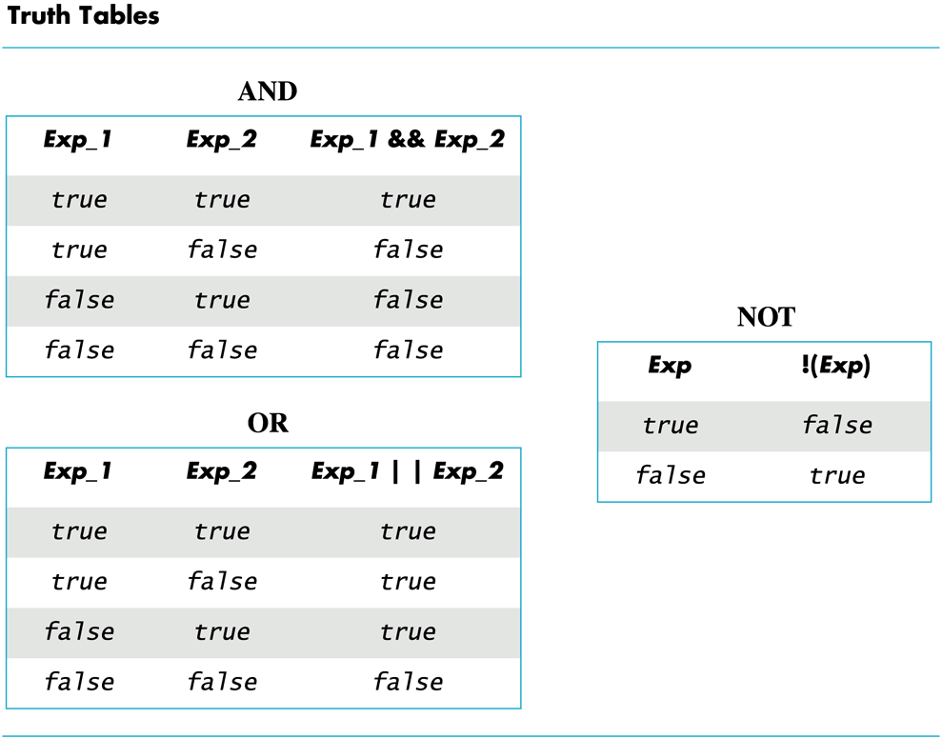
Slide 3- <number>

Slide 8
Order of Precedence: boolean expression
If parenthesis are omitted from boolean expressions, default precedence of operations is:
  Perform ! operations first
  Perform relational operations such as < next
  Perform && operations next
  Perform | | operations last
Slide 3- <number>

Slide 9
Precedence Rules
Items in expressions are grouped by precedence
rules for arithmetic and boolean operators
  Operators with higher precedence are performed first
  Binary operators with equal precedence are
  performed left to right
  Unary operators of equal precedence are
  performed right to left
Slide 3- <number>

Slide 10
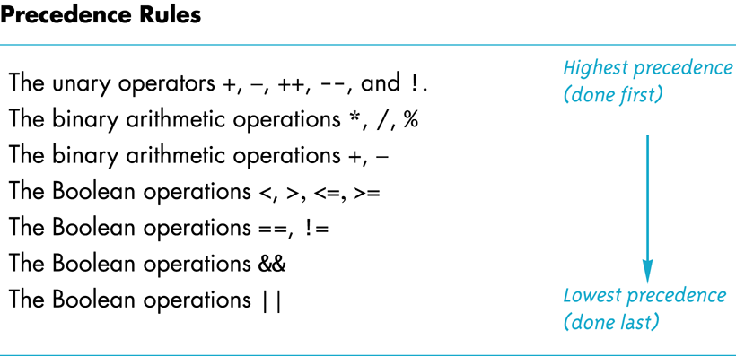
Slide 3- <number>

Slide 11
Precedence Rule Example
The expression
(x+1) > 2 | | (x + 1) < -3
is equivalent to
( (x + 1) > 2) | | ( ( x + 1) < -3)
Because > and < have higher precedence than | |, and is equivalent to
x + 1 > 2 | | x + 1 < - 3
Evaluating x + 1 > 2 | | x + 1 < - 3
  First apply the unary –
  Next apply the +'s
  Now apply the > and <
  Finally do the | |
Slide 3- <number>

Slide 12
Short-Circuit Evaluation (lazy evaluation)
Sometimes, boolean expressions do not need to be completely evaluated
  E.g., if x is negative, the value of expression
  (x >= 0) && ( y > 1)
  can be determined by evaluating only (x >= 0)
C++ short-circuit evaluation
  If value of leftmost sub-expression
  determines final value of expression, rest
  of expression is not evaluated
  E.g., (x==1 || x==2) if x equals to 1, second part is not evaluated
Slide 3- <number>

Slide 13
Using Short-Circuit Evaluation
to prevent run-time errors
  Consider
  if ((kids != 0) && (pieces / kids >= 2) )
  cout << "Each child may have two pieces!“;
  If value of kids is zero, short-circuit evaluation
  prevents evaluation of (pieces / 0 >= 2)
    Division by zero causes a run-time error
Slide 3- <number>

Slide 14
Type bool and Type int
C++ can use integers as if they were Boolean
values
  Any non-zero number (typically 1) is true
  0 (zero) is false
E.g., int n = 10;
  while (n)
  {
  cout <<″*″;
  n--;
  }
Slide 3- <number>

Slide 15
Problems with !
The expression ( ! time > limit ), with limit = 60,
is evaluated as
(!time) > limit
If time is an int with value 36, what is !time?
  False or zero since it will be compared to an integer
  The expression is further evaluated as
  0 > limit
  false
The intent of the previous expression was most likely the expression
( ! ( time > limit) )
which evaluates as
( ! ( false) )
true
Slide 3- <number>

Slide 16
Avoiding !
Just as not in English can make things not undifficult to read, the ! operator can make C++ expressions difficult to understand
Before using the ! operator see if you can express the same idea more clearly without the ! operator
Slide 3- <number>

Slide 17
Exercise
Determine the value of these Boolean expressions, assuming count is 0 and limit is 10?
  (count == 0) && (limit < 20)
  !(count == 12)
  (limit < 0) && ((limit /count) > 7)
  (limit && count==0)
Slide 3- <number>

Slide 18
Overview
Using Boolean Expressions
  Truth table, evaluate boolean expression
  Precedence
Multiway Branches
  nested if-else statement
  switch statement
More about C++ Loop Statements
Designing Loops
Slide 3- <number>

Slide 19
Multiway Branches
A branching mechanism selects one out of a number of alternative actions
  An if-else-statement is a two-way branch
  Three or four (or more) way branches: can be designed using nested if-else-statements
    Where an if-else statement is a part of another if-else statement
  e.g., if (count < 10)
  if ( x < y)
  cout << x << " is less than " << y;
  else
  cout << y << " is less than " << x;
Slide 3- <number>

Slide 20
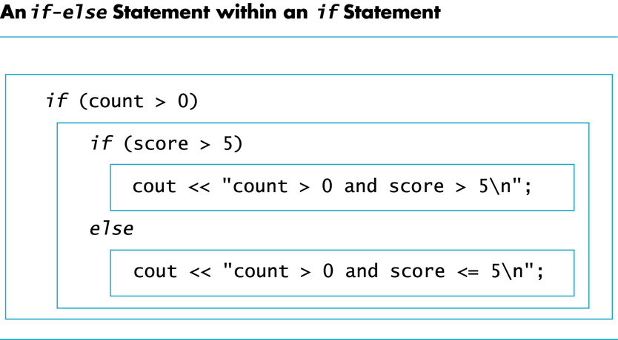
Slide 3- <number>

Slide 21
Nested if-else statements
Example: To design an if-else statement to warn a driver when fuel is low, but tells the driver to bypass pit stops if the fuel is close to full. Otherwise there should be no output.
Pseudocode: if fuel gauge is below ¾ then:
if fuel gauge is below ¼ then:
issue a warning
otherwise (gauge > ¾) then:
output a statement saying don't stop
Slide 3- <number>

Slide 22
First Try Nested if's
Translating the previous pseudocode to C++ could yield
if (fuel_gauge_reading < 0.75)
if (fuel_gauge_reading < 0.25)
cout << "Fuel very low. Caution!\n";
else
cout << "Fuel over 3/4. Don't stop now!\n";
  compile and run, but does not produce desired results
    When fuel_gauge_reading is 0.3, it prints “Fuel over ¾, Don’t stop now!”
Why?
Slide 3- <number>

Slide 23
Dangling else problem
There is ambiguity in the code below
  There are two if, only one else
  Which if is this “else” for?
  This is sometimes called Dangling else problem.
  if (fuel_gauge_reading < 0.75)
  if (fuel_gauge_reading < 0.25)
  cout << "Fuel very low. Caution!\n";
  else
  cout << "Fuel over 3/4. Don't stop now!\n";
C++ standard: pairs the "else" with nearest previous "if"
Slide 3- <number>

Slide 24
Braces and Nested Statements
Braces in nested statements are like parenthesis in expressions
  To pair else with first if: use {} to enclose the if statement.
  if (fuel_gauge_reading < 0.75)
  {
  if (fuel_gauge_reading < 0.25)
  cout << "Fuel very low. Caution!\n";
  }
  else
  cout << "Fuel over 3/4. Don't stop now!\n";
Slide 3- <number>

Slide 25
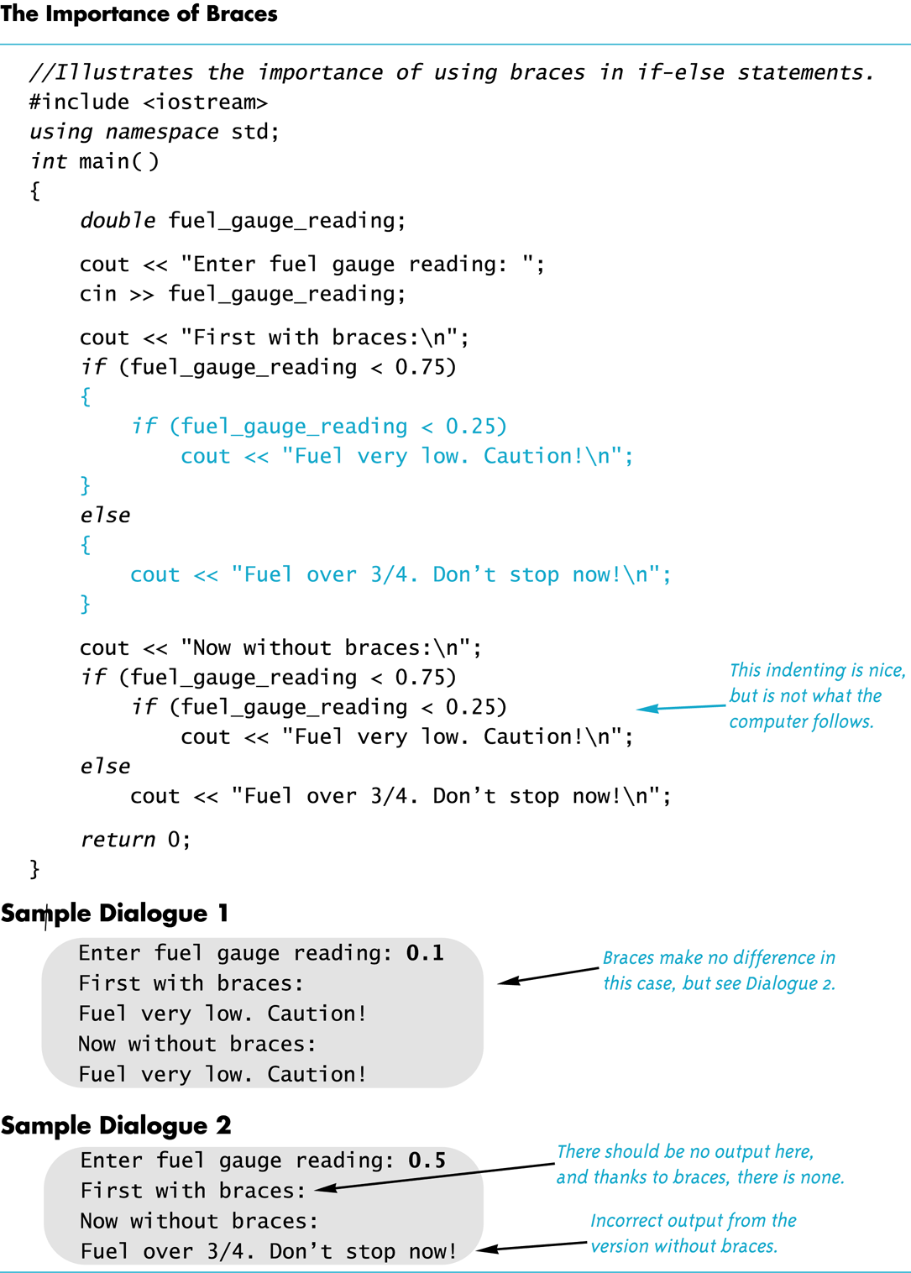
Slide 3- <number>

Slide 26
Multi-way if-else-statements:
Number Guessing
number guessing game:
  if (guess> number)
  cout << "Too high.";
  else
  if (guess < number)
  cout << "Too low.");
  else
  if (guess == number)
  cout << "Correct!";
  If there are more nested if statements, indentation levels keep increasing, less and less space …
Slide 3- <number>

Slide 27
Indenting Nested if-else
Alternative indentation for nested if-else-statements:
if (guess> number)
cout << "Too high.";
else if (guess < number)
cout << "Too low.");
else if (guess == number)
cout << "Correct!";
Slide 3- <number>

Slide 28
Final if-else-statement
When conditions tested in an if-else-statement are mutually exclusive, final if can sometimes be omitted.
  if (guess> number)
  cout << "Too high.";
  else if (guess < number)
  cout << "Too low.");
  else // (guess == number), sure guess must be equal to number
  cout << "Correct!";
Slide 3- <number>

Slide 29
Nested if-else Syntax
  if (Boolean_Expression_1)
  Statement_1
  else if ( Boolean_Expression_2)
  Statement_2
  …
  else if (Boolean_Expression_n)
  Statement _n
  else
  Statement_For_All_Other_Possibilities
Slide 3- <number>

Slide 30
Review: if statements
To implement branching, use if statements
if (boolean_expression)
statement1
else
statement2
if (boolean_expression)
statement
Boolean expression is
enclosed by ( )
statements should be indented by one more level. It can be
simple statement
block statement, i.e.,
a sequence statement enclosed with { }
empty statement
loop statement
if statement, i.e., nested if statement
Slide 1- <number>

Slide 31
Making sense of statements…
By default language is English. If the country is USA and the state is PR, then set the language to Spanish. If the country is China, set the language to Chinese.
string language=″English″;
if (country==″USA″)
if (state==″PR″) language=″Spanish″;
else if (country==″China″)
language=″Chinese″;
First: try to rewrite it using our indentation convention
Slide 1- <number>

Slide 32
Exercise
Write a code segment that assign appropriate value to variable days_in_month, based on value of variable month
int month,days_in_month;
cin >> month;
//your code here … assuming month takes value between
// 1 and 12, and assuming it’s not leap year
Slide 1- <number>

Slide 33
Program Example: State Income Tax
Write a program for a state that computes tax according to rate schedule:
No tax on first $15,000 of income
5% tax on each dollar from $15,001 to $25,000
10% tax on each dollar over $25,000
Slide 3- <number>

Slide 34
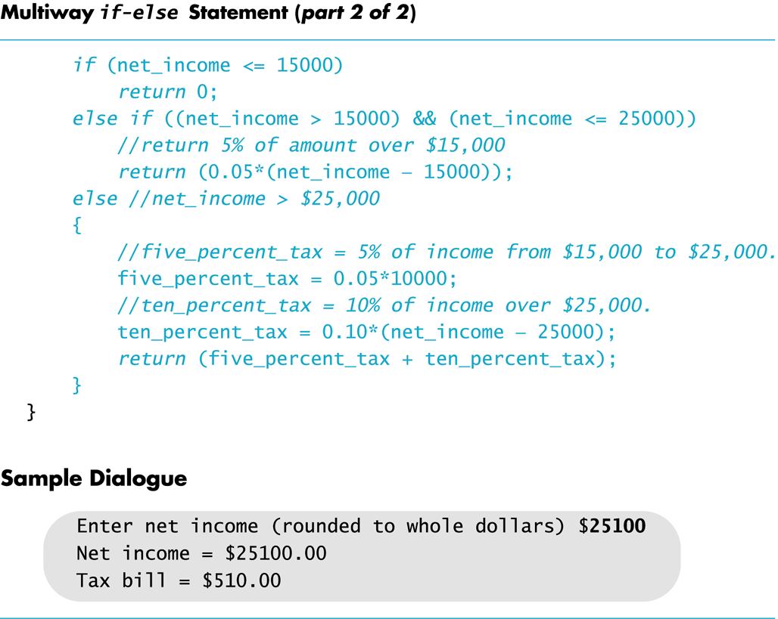
else if (net_income <= 25000)
Slide 3- <number>

Slide 35
Overview
Using Boolean Expressions
  Truth table, evaluate boolean expression
  Precedence
Multiway Branches using Embedded if-else statement
Coding Style and Errors
Multiway Branches using switch statement
C++ Loop Statements: while, do/while loop,
C++ Loop Statements: for loop
Designing Loops
Slide 3- <number>

Slide 36
Program Style
A program written with attention to style
  is easier to read
  easier to correct
  easier to change
Indentations, Comments, Named Constants

Slide 37
Program Style - Indenting
Items considered a group should look like a group
  Skip lines between logical groups of statements
  Indent statements within statements
  if (x = = 0)
  statement;
Braces {} create groups
  Indent within braces to make the group clear
  Braces placed on separate lines are easier to locate

Slide 38
Program Style - Comments
// is the symbol for a single line comment
  Comments are explanatory notes for the programmer
  All text on the line following // is ignored by the
  compiler
  Example: //calculate regular wages
  gross_pay = rate * hours;
/* and */ enclose multiple line comments
  Example: /* This is a comment that spans
  multiple lines without a
  comment symbol on the middle line
  */

Slide 39
Program Style - Constants
Number constants have no mnemonic value
Number constants used throughout a program
are difficult to find and change when needed
Constants
  Allow us to name number constants so they have
  meaning
  Allow us to change all occurrences simply by
  changing the value of the constant

Slide 40
Constants
const is the keyword to declare a constant
Example:
const int WINDOW_COUNT = 10;
declares a constant named WINDOW_COUNT
  Its value cannot be changed by program like a variable
  It is common to name constants with all capitals
Create a named constant of type double with its value being 3.1415?

Slide 41
Overview
Using Boolean Expressions
  Truth table, evaluate boolean expression
  Precedence
Multiway Branches using Embedded if-else statement
Coding Style and Errors
Multiway Branches using switch statement
C++ Loop Statements: while, do/while loop,
C++ Loop Statements: for loop
Designing Loops
Slide 3- <number>

Slide 42
switch-statement
switch-statement: for constructing multi-way branches
switch (controlling expression)
{
case constant_1:
statement_Sequence_1
break;
case constant_2:
statement_Sequence_2
break;
. . .
case constant_n:
statement_Sequence_n
break;
default:
default_Statement_Sequence
}
Slide 3- <number>

Slide 43
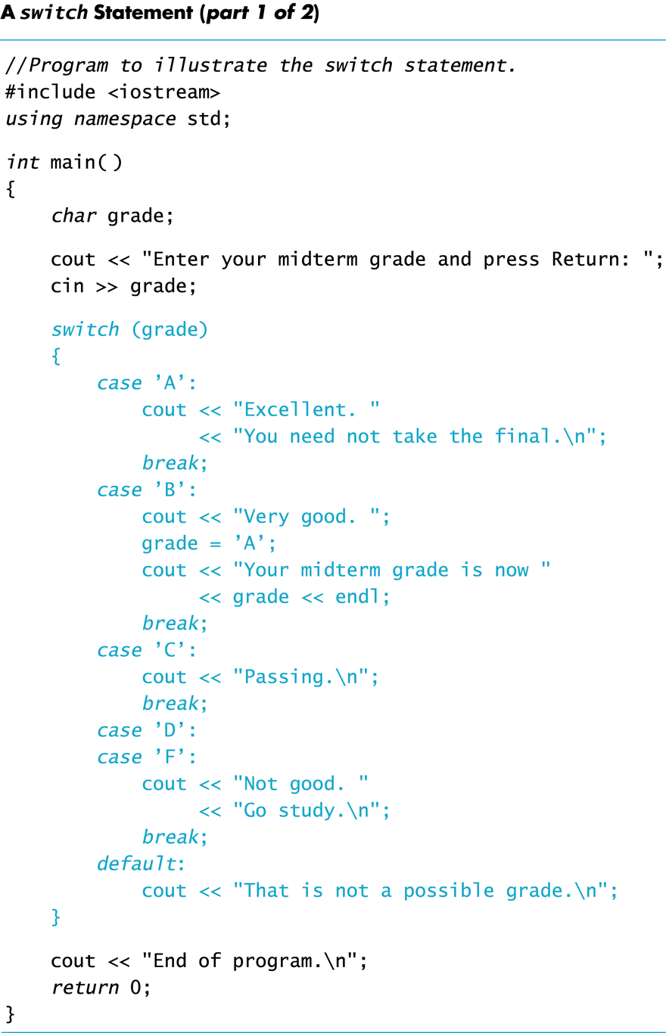
Slide 3- <number>

Slide 44
Understanding switch statement
switch (controlling expression)
{
case constant_1: statement_Sequence_1
break;
case constant_2: statement_Sequence_2
break;
. . .
case constant_n:
statement_Sequence_n
break;
default:
default_Statement_Sequence
}
A switch statement's controlling expression must be one of these types: bool, int, long, char
Control expression’s value is first evaluated, and then compared to constant values after each "case"
  When a match is found, the code for that case is executed
Slide 3- <number>

Slide 45
Understand switch statement (cont’d)
break statement: “break out” of switch statement, i.e., go to next statement after the switch
Usually: we use a break at the end of the statement sequence for each case
Omitting break statement will cause the code for the next case to be executed!
  Cascading effect, or falling-through …
  This allows us to use multiple case labels for a section of code
  case 'A':
  case 'a':
  cout << "Excellent.";
  break;
  Runs the same code for either 'A' or 'a'
Slide 3- <number>

Slide 46
default case
If no case label has a constant that matches controlling expression, statements following default label are executed
  If there is no default label, nothing happens when the switch statement is executed
It is a good idea to include a default section
Slide 3- <number>

Slide 47
Nested if/else vs switch
Nested if-else statements are more versatile than
a switch statement
  Question: can switch statement be used to computes tax according to rate schedule:
  No tax on first $15,000 of income
  5% tax on each dollar from $15,001 to $25,000
  10% tax on each dollar over $25,000
Switch-statements can make some code more
clear
  A menu is a natural application for a switch-statement
Slide 3- <number>

Slide 48
switch statement exercise
Can we use switch statement to rewrite the expression.cpp?
  What is used to control/select which branch to execute?
Can we use switch statement to set the days_in_month based upon month? (i.e., if month is 1,3,5,7,8,10,12, days_in_month is set to 31, …)?
  Would you choose nested if/else or switch?
Slide 3- <number>

Slide 49
Overview
Using Boolean Expressions
  Truth table, evaluate boolean expression
  Precedence
Multiway Branches using Embedded if-else statement
Multiway Branches using switch statement
Coding Style and Errors
C++ Loop Statements: while, do/while loop,
C++ Loop Statements: for loop
Designing Loops
Slide 3- <number>

Slide 50
Loop statement to repeat an action
To repeat an action, we use a loop
For example, to output ”Hello” for ten times, we can:
e.g.,
int count=10;
while (count> 0)
{
cout << "Hello ";
count -= 1;
}
Output: Hello Hello Hello Hello Hello …. Hello

Slide 51
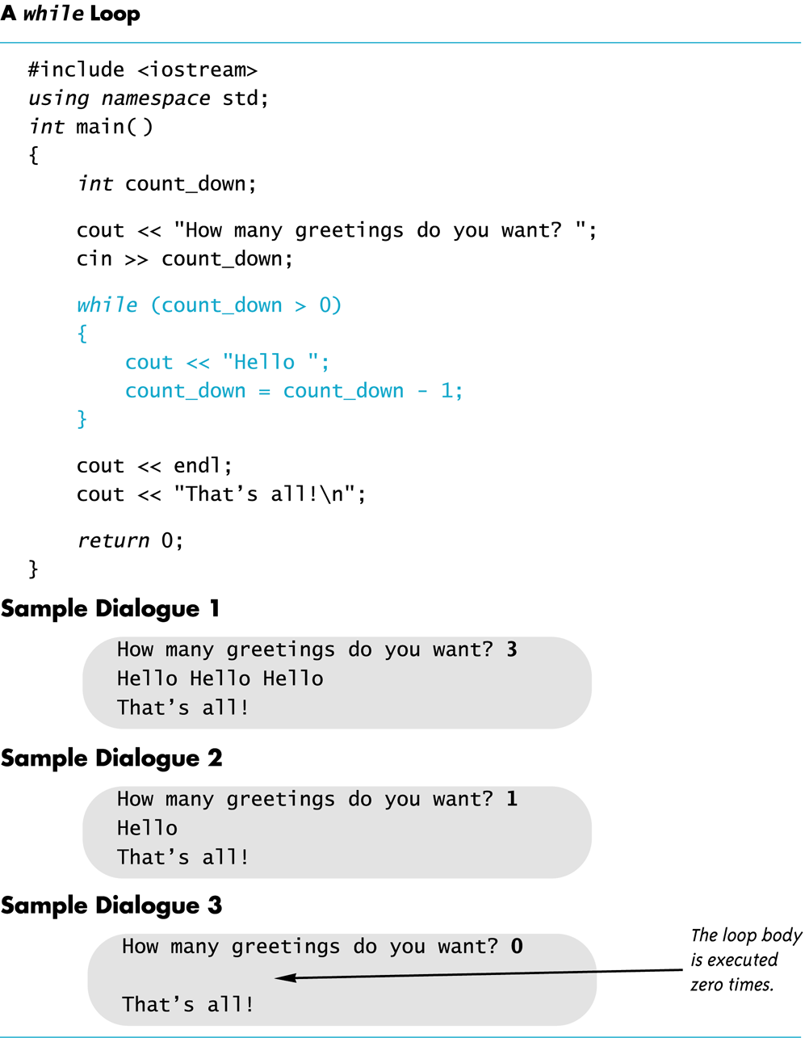

Slide 52
While Loop Operation
Boolean expression
First, boolean expression is evaluated
  If false, program skips to line following
  while loop
  If true, body of loop is executed
    During execution, some item from boolean expression is changed
After executing loop body, boolean
expression is checked again: repeating process until expression becomes false
A while loop might not execute at all if
boolean expression is false on the first check
count_down = 3;
while (count_down > 0)
{
cout << "Hello ";
count_down -= 1;
}
Statement follows while loop
The body of loop

Slide 53
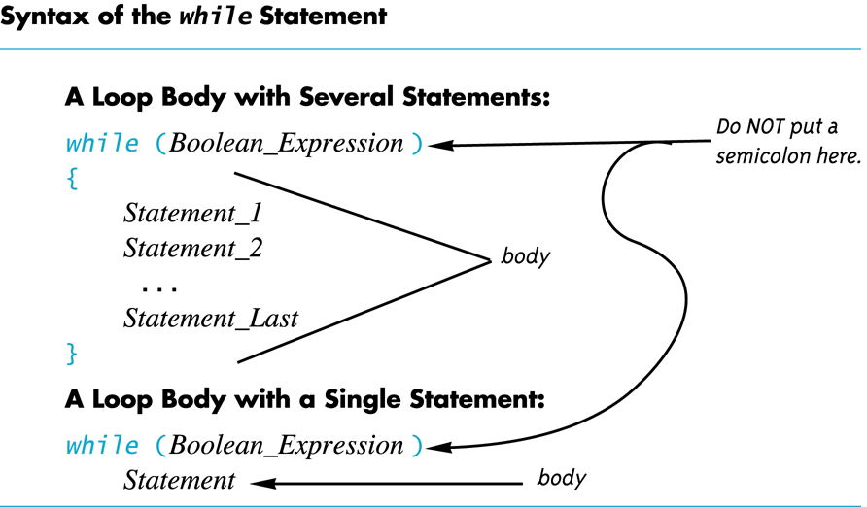

Slide 54

Exercise
Can you write a program that prints numbers 1,2,3…,100 to the terminal?
Write a program that
  Ask the user to enter an integer
  Calculate the sum of all numbers from 1 to this number
  Output the result
Write some code segment to keep reading from cin the number of 12 inch pizza until the user enter a non-negative number.

Slide 55
do-while loop
A do-while loop is always executed at least once
  body of the loop is first executed
  boolean expression is checked after the body
  has been executed
Syntax:
do
{
statements to repeat
} while (boolean_expression);

Slide 56
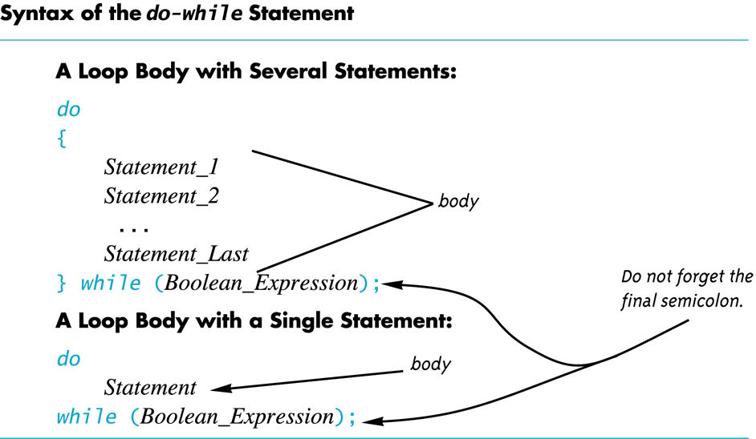

Slide 57
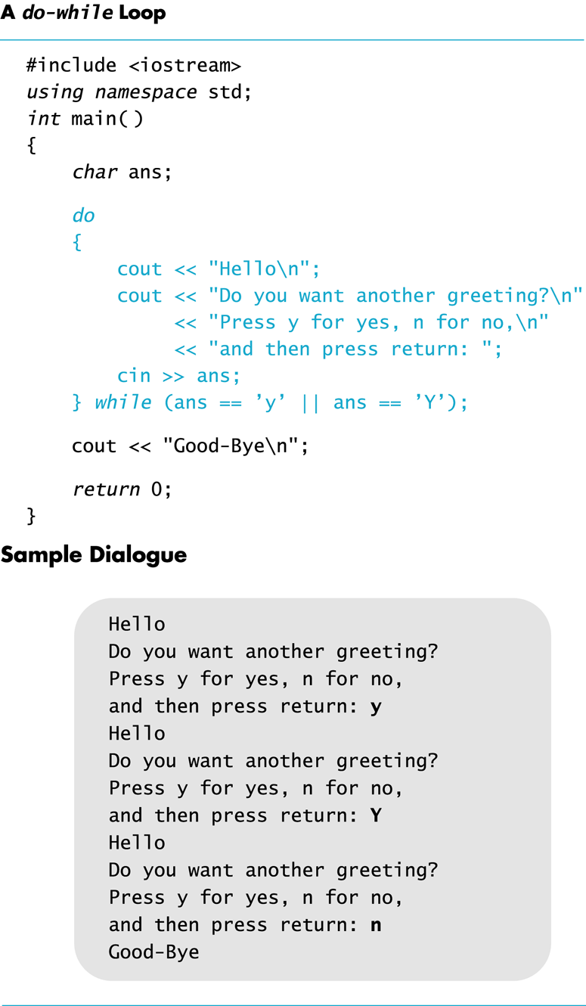
Slide 2- <number>

Slide 58
Sample Program
Bank charge card balance of $50
2% per month interest
How many months without payments before
your balance exceeds $100
After 1 month: $50 + 2% of $50 = $51
After 2 months: $51 + 2% of $51 = $52.02
After 3 months: $52.02 + 2% of $52.02 …

Slide 59
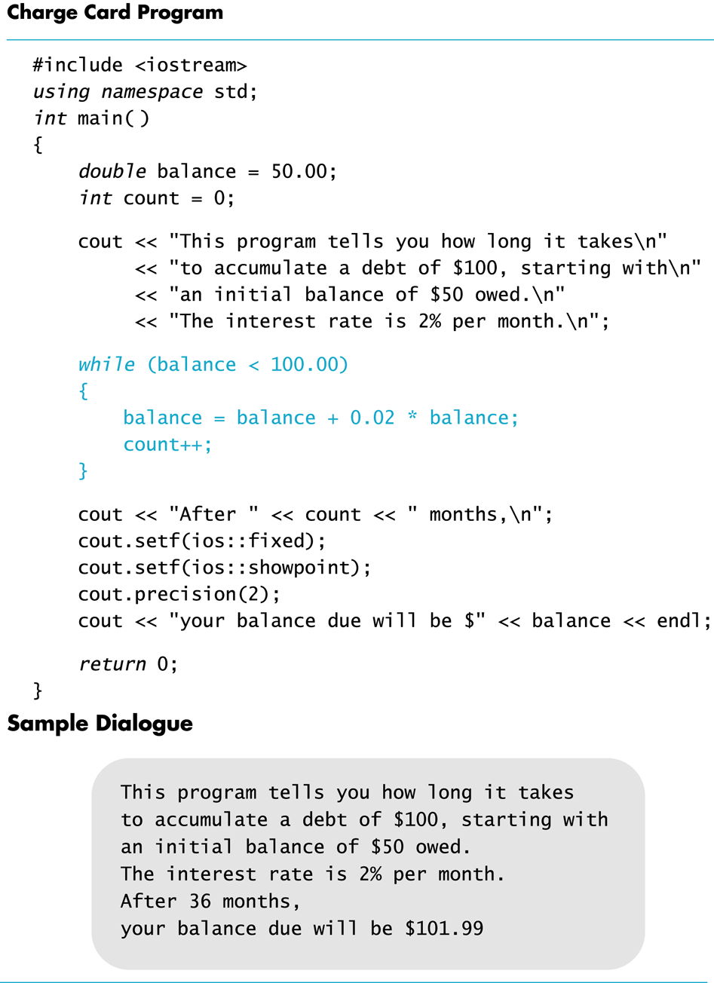

Slide 60
Infinite Loops
infinite loops: loops that never stop are
  loop body should contain a line that will eventually cause boolean expression to become false
e.g.,: print odd numbers less than 12
x = 1;
while (x != 12)
{
cout << x << endl;
x = x + 2;
}
Better to use this comparison: while ( x < 12)

Slide 61
Exercises
Can you show the output of this code if x is of type int?
x = 10;
while ( x > 0)
{
cout << x << endl;
x = x – 3;
}
  Show the output of the previous code using the
  comparison x < 0 instead of x > 0?

Slide 62
C++ Loop Statements
A loop is a program construction that repeats a statement or sequence of statements a number of times
  The body of the loop is the statement(s) repeated
  Each repetition of the loop is an iteration
Loop design questions:
  What should loop body be?
  How many times should the body be iterated?
Slide 3- <number>

Slide 63
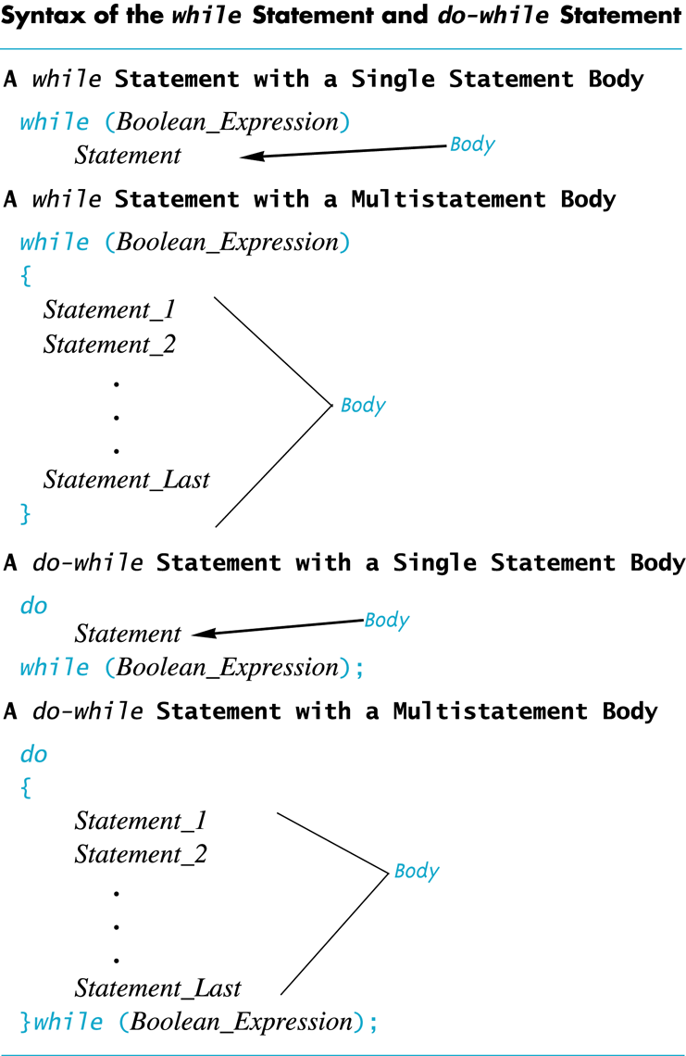
Review: while and do-while
A while loop checks the Boolean expression at the beginning of the loop
  A while loop might never be executed!
A do-while loop checks the Boolean expression at the end of the loop
  A do-while loop is always executed at least once
Slide 3- <number>

Slide 64
What’s the problem with the code?
Prompt the user to enter the month, check if the input is valid (whether the value is between 1 and 12). Repeat it until the input is valid.
cout << “Enter the month::”;
int month;
cin >> month;
while (month >12 || month <1);
cout <<“Invalid input. Try again:”;
cin >> month;
Slide 1- <number>

Slide 65
Overview
Using Boolean Expressions
  Truth table, evaluate boolean expression
  Precedence
Multiway Branches using Embedded if-else statement
Multiway Branches using switch statement
Coding Style and Errors
C++ Loop Statements: while, do/while loop,
  for loop
C++ Loop Statements: for loop
Designing Loops
Slide 3- <number>

Slide 66
For loop
For loop: more compact form
  Normally used to write a loop with known iteration numbers
for loop to add the numbers 1 - 10
sum = 0;
for (n = 1; n <= 10; n++)
sum = sum + n;
while loop for same task
  sum = 0;
  n = 1;
  while (n <= 10)
  {
  sum = sum + n;
  n++;
  }
Slide 3- <number>

Slide 67
For Loop Dissection
  for (n = 1; n <= 10; n++)
  sum = sum + n;
Boolean
Expression
Initialization Action
Update Action
Loop body
initialize n with value1
Continue to iterate the body as long as n <= 10
Increment n by one after each iteration
Slide 3- <number>

Slide 68
For loop => while loop
sum = 0;
for (n = 1; n <= 10; n++)
sum = sum + n;
sum = 0;
n = 1;
while (n <= 10)
{
sum = sum + n;
n++;
}
Slide 3- <number>

Slide 69
for Loop Alternative
A for loop can also include a variable declaration in initialization action
  for (int n = 1; n < = 10; n++)
  This line means
    Create a variable, n, of type int and initialize it with 1
    Continue to iterate the body as long as n <= 10
    Increment n by one after each iteration
Slide 3- <number>

Slide 70
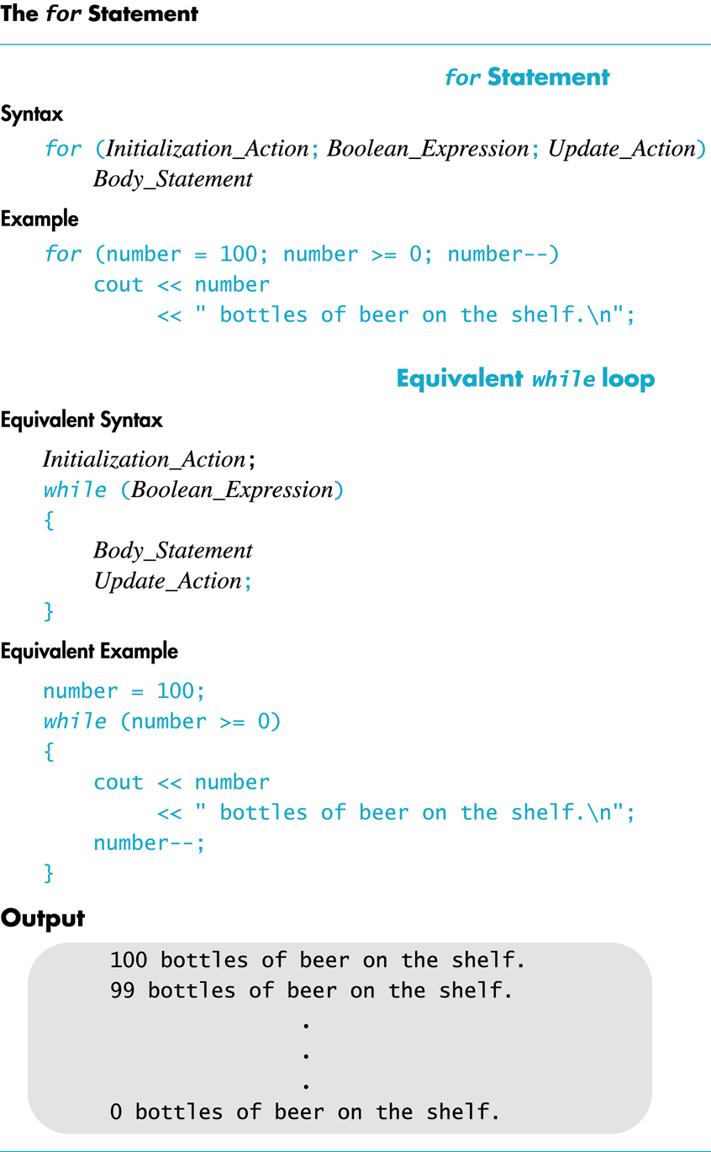
Slide 3- <number>

Slide 71
for-loop Details
Initialization and update actions of for-loops often contain more complex expressions
  for (n = 1; n < = 10; n = n + 2)
  for(n = 0 ; n > -100 ; n = n -7)
  for(double x = pow(y,3.0); x > 2.0; x = sqrt(x) )
Slide 3- <number>

Slide 72
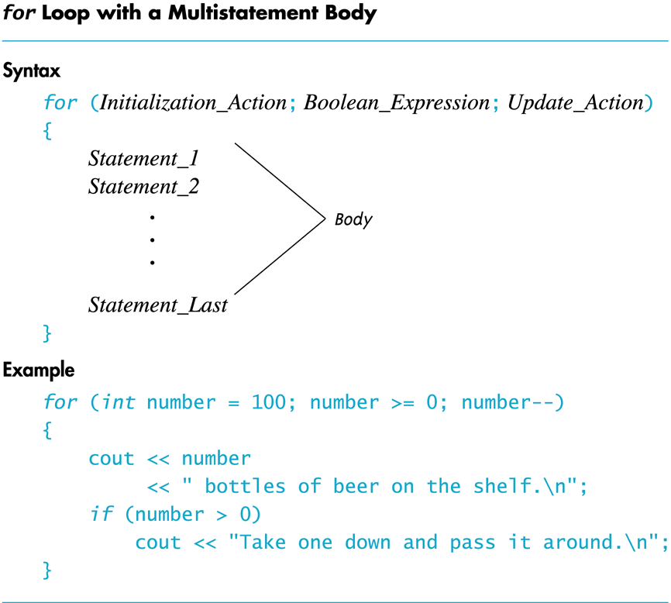
Slide 3- <number>

Slide 73
Exercise: how many Hello?
  for(int count = 1; count <= 10; count++);
  cout << "Hello\n";
    prints one "Hello", but not as part of the loop!
    The empty statement is the body of the loop
    cout << "Hello\n"; is not part of the loop body!
Slide 3- <number>

Slide 74
Break statement
There are times to exit a loop before it ends
  If loop checks for invalid input that would ruin a calculation, it is often best to end the loop
Break statement can be used to exit a loop before normal termination
In nested loops, break only exits loop in which break-statement occurs
Slide 3- <number>

Slide 75
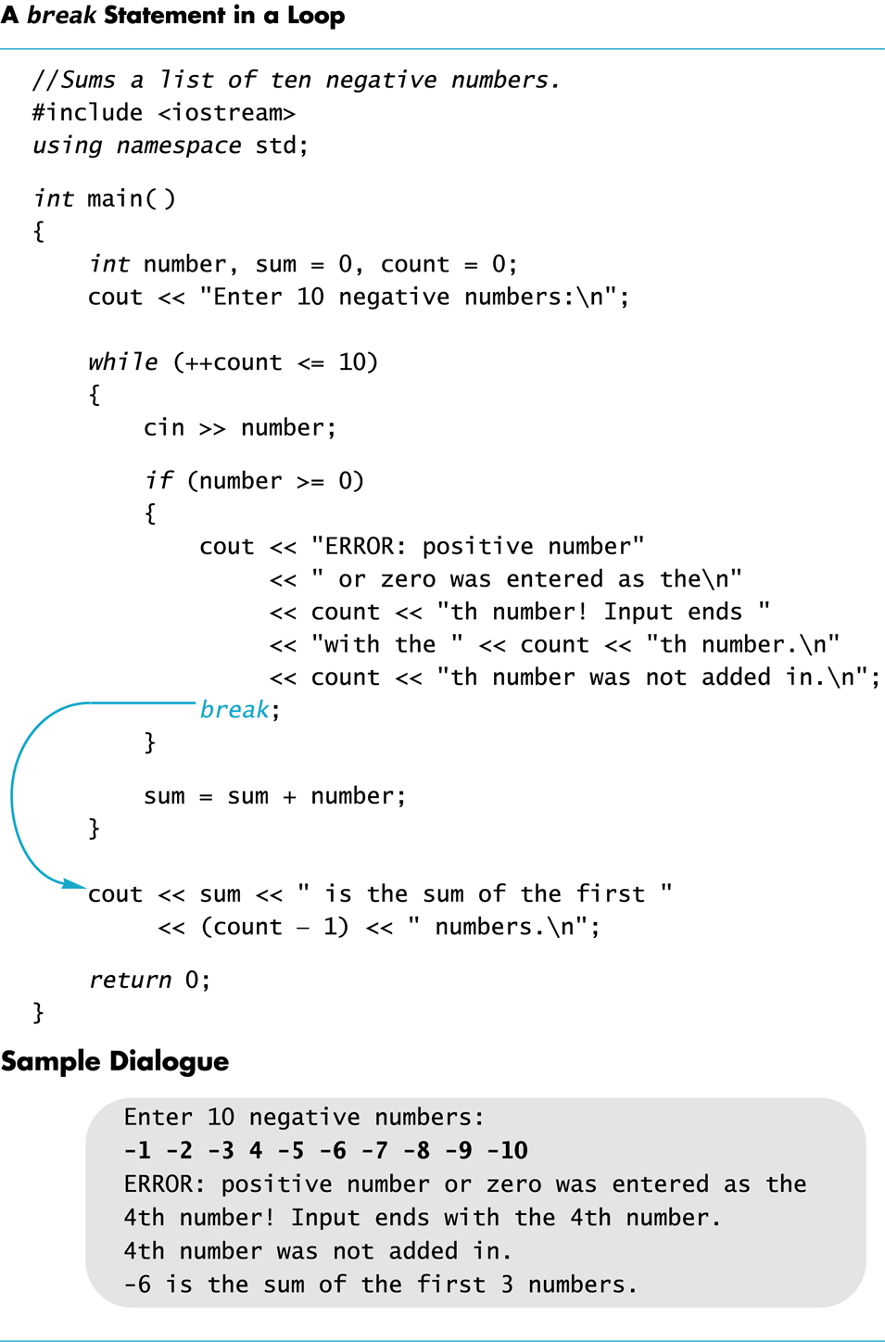
Slide 3- <number>

Slide 76
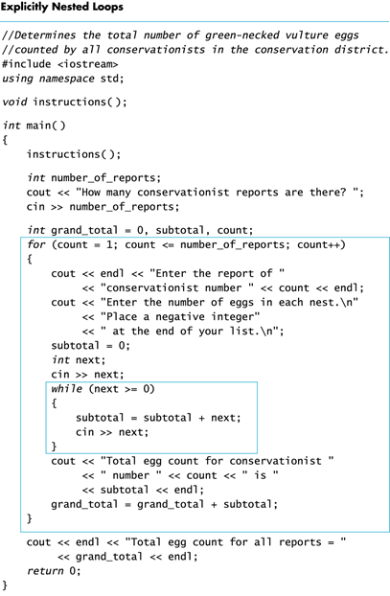
Nested Loops
The body of a loop may contain any kind of statement, including another loop, if statement
When loops are nested, all iterations of inner loop
are executed for each iteration of the outer loop
Slide 3- <number>

Slide 77
Exercise
Determine the output of the following?
for(int count = 1; count < 5; count++)
cout << (2 * count) << " " ;
Write a for loop to calculate the sum 1/2 + 1/3 + 1/4 + … + 1/10
Slide 3- <number>

Slide 78
Overview
Using Boolean Expressions
  Truth table, evaluate boolean expression
  Precedence
Multiway Branches using Embedded if-else statement
Multiway Branches using switch statement
Coding Style and Errors
C++ Loop Statements: while, do/while loop,
  for loop
C++ Loop Statements: for loop
Designing Loops
Slide 3- <number>

Slide 79
Overview
Using Boolean Expressions
  Truth table, evaluate boolean expression
  Precedence
Multiway Branches using Embedded if-else statement
Multiway Branches using switch statement
Coding Style and Errors
C++ Loop Statements: while, do/while loop,
  for loop
C++ Loop Statements: for loop
Designing Loops
Slide 3- <number>

Slide 80
Designing Loops
Designing a loop involves designing
  The body of the loop
  The initializing statements
  The conditions for ending the loop
Slide 3- <number>

Slide 81
Which Loop To Use?
Choose the type of loop late in the design process
  First design the loop using pseudocode
Translate pseudocode into C++
  for-loops: when doing numeric calculations, especially when using a variable changed by equal amounts each time the loop iterates
  While-loops:
    When a for-loop is not appropriate
    When there are circumstances for which loop body should not be executed at all
  Do-while loops:
    When a for-loop is not appropriate
    When the loop body must be executed at least once
Slide 3- <number>

Slide 82
Sums and Products
A common task is reading a list of numbers and computing the sum
Pseudocode for this task might be:
sum = 0;
repeat the following this_many times
cin >> next;
sum = sum + next;
end of loop
Pseudocode containing the line
repeat the following "this many times"
is often implemented with a for-loop
Slide 3- <number>

Slide 83
for-loop for a sum
int sum = 0;
for(int count=1; count <= this_many; count++)
{
cin >> next;
sum = sum + next;
}
  A for-loop is generally the choice when there is
  a predetermined number of iterations
  sum must be initialized prior to the loop body!
Slide 3- <number>

Slide 84
for-loop For a Product
Forming a product is very similar to the sum example seen earlier
int product = 1;
for(int count=1; count <= this_many; count++)
{
cin >> next;
product = product * next;
}
  product must be initialized prior to the loop body
  Notice that product is initialized to 1, not 0!
Slide 3- <number>

Slide 85
Ending a read input Loop
Four common methods to terminate a loop that reads inputs from keyboard
  List headed by size
    When we can determine the size of the list beforehand
  Ask before iterating
    Ask if the user wants to continue before each iteration
  List ended with a sentinel value
    Using a particular value to signal the end of the list
  Running out of input
    Using the eof function to indicate the end of a file
Slide 3- <number>

Slide 86
List Headed By Size
The for-loops we have seen provide a natural implementation of the list headed by size method of ending a loop
int items;
  cout << "How many items in the list?";
  cin >> items;
  for(int count = 1; count <= items; count++)
  {
  int number;
  cout << "Enter number " << count;
  cin >> number;
  cout << endl;
  // statements to process the number
  }
Slide 3- <number>

Slide 87
Ask Before Iterating
A while loop is used here to implement the ask before iterating method to end a loop
sum = 0;
cout << "Are there numbers in the list (Y/N)?";
char ans;
cin >> ans;
while (( ans = 'Y') || (ans = 'y'))
{
//statements to read and process the number
cout << "Are there more numbers(Y/N)? ";
cin >> ans;
}
Slide 3- <number>

Slide 88
List Ended With a Sentinel Value
A while loop is typically used to end a loop using the list ended with a sentinel value method
cout << "Enter a list of nonnegative integers.\n"
<< "Place a negative integer after the list.\n";
sum = 0;
cin >> number;
while (number > 0)
{
//statements to process the number
cin >> number;
}
  Notice that the sentinel value is read, but not processed
Slide 3- <number>

Slide 89
Running Out of Input
while loop is typically used to implement running out of input method of ending a loop
ifstream infile;
infile.open("data.dat");
while (! infile.eof( ) )
{
// read and process items from the file
// File I/O covered in Chapter 6
}
infile.close( );
Slide 3- <number>

Slide 90
General Methods To Control Loops
Counter controlled loops: the number of iterations predetermined before loop begins
  E.g., list headed by size
Ask before iterating
Exit on flag condition: loops ended when a particular flag condition exists
  A variable that changes value to indicate that some event has taken place is a flag
  E.g., List ended with a sentinel value, running out of input
Slide 3- <number>

Slide 91
Exit on Flag Caution
Consider this loop to identify a student with a grade of 90 or better
int n = 1;
grade = compute_grade(n);
while (grade < 90)
{
n++;
grade = compute_grade(n);
}
cout << "Student number " << n
<< " has a score of " << grade << endl;
What if no student has a grade of 90 or higher?
Slide 3- <number>

Slide 92
Exit On Flag Solution
This code solves the problem of having no student grade at 90 or higher
int n=1;
grade = compute_grade(n);
while (( grade < 90) && ( n < number_of_students))
{
// same as before
}
if (grade > 90)
// same output as before
else
cout << "No student has a high score.";
a second flag: ensure there are still students to consider
Slide 3- <number>

Slide 93
Debugging Loops
Off-by-one errors: loop executes one too many or one too few times
  Check your comparison:
  should it be < or <=?
  Check that the initialization uses the correct value
  Does the loop handle the zero iterations case?
Infinite loops: usually result from a mistake in Boolean expression that controls the loop
  Check direction of inequalities:
  < or > ?
  Test for < or > rather than equality (==)
    Remember that doubles are really only approximations
Slide 3- <number>

Slide 94
Loop Debugging Tips
Be sure that the mistake is really in the loop
Trace variable to observe how the variable changes
  Tracing a variable is watching its value change during execution
    Many systems include utilities to help with this
  cout statements can be used to trace a value
Slide 3- <number>

Slide 95
Debugging Example
following code is supposed to conclude with variable product containing the product of the numbers 2 through 5, i.e.,
2*3*4*5
int next = 2, product = 1;
while (next < 5)
{
next++;
product = product * next;
}
Slide 3- <number>

Slide 96
Tracing Variables
Add temporary cout statements to trace variables
int next = 2, product = 1;
while (next < 5)
{
next++;
product = product * next;
cout << "next = " << next
<< "product = " << product
<< endl;
}
next=3 product=3
next=4 product=12
next=5 product=60
Problem: 2 is not multiplied into product…
Slide 3- <number>

Slide 97
First Fix
Solve the problem by moving the statement next++
int next = 2, product = 1;
while (next < 5)
{
product = product * next;
next++;
cout << "next = " << next
<< "product = " << product
<< endl;
}
There is still a problem!
Slide 3- <number>

Slide 98
Second Fix
New problem: loop never multiplies by 5
  The fix is to use <= instead of < in our comparison
  int next = 2, product = 1;
  while (next <= 5)
  {
  product = product * next;
  next++;
  }
Slide 3- <number>

Slide 99
Loop Testing Guidelines
Every time a program is changed, it must be retested
  Changing one part may require a change to another
Every loop should at least be tested using input to cause:
  Zero iterations of the loop body
  One iteration of the loop body
  One less than the maximum number of iterations
  The maximum number of iterations
Slide 3- <number>

Slide 100
Starting Over
Sometimes it is more efficient to throw out a
buggy program and start over
  The new program will be easier to read
  The new program is less likely to be as buggy
  You may develop a working program faster than if you repair the bad code
    The lessons learned in the buggy code will help you
    design a better program faster
Slide 3- <number>

Slide 101
Summary
Using Boolean Expressions
  Truth table, evaluate boolean expression
  Precedence Rules
Multiway Branches
  Nested if-else statement
  Switch statement
More about C++ Loop Statements
Designing Loops
Slide 3- <number>

